Slide 1

WORLDWIDE ENERGY CONSUMPTION ANALYSIS
Presented by :
1) P. Deekshitha
2) B. Nageshwari
3) N. Anuhya

Slide 2
Agenda
Objectives of the Project
ER Diagram and schema explanation
Key analysis questions (USE CASES)
SQL query results with summaries
Final Business Insights
Conclusion

Slide 3
OBJECTIVES
Main Goals of the SQL Project
To store and manage large-scale energy data efficiently using a relational database
To perform structured data analysis using SQL queries
To analyze energy consumption, production, emissions, GDP, and population trends
To compare countries and identify top contributors to energy use and emissions
To calculate ratios and per-capita metrics for meaningful comparisons
To identify patterns, trends, and relationships in real-world data
To support data-driven insights for sustainable energy and policy decisions

Slide 4
DATASET & DATABASE CONTEXT
Structured global energy dataset with 6 interrelated tables:
Country, Consumption, Production, Emission, GDP, and Population
Country table acts as the central reference
Other tables are linked using foreign key relationships
Year-wise data enables trend and year-over-year analysis
Relational structure supports efficient SQL queries and accurate comparisons
Helps analyze relationships between energy usage, economic growth, population, and emissions

Slide 5
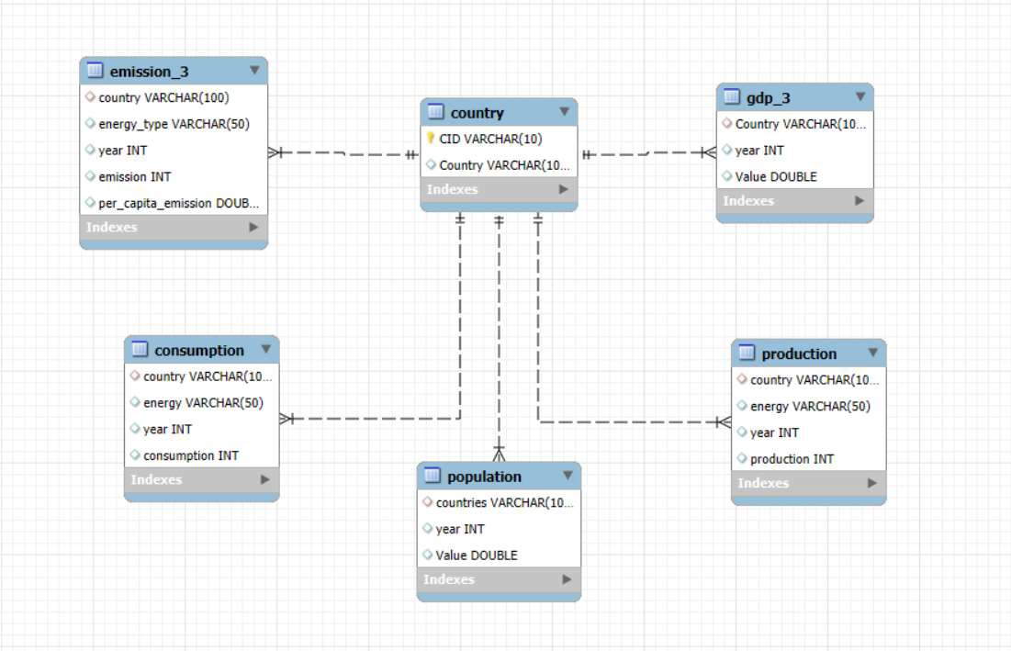
ER DIAGRAM
One-to-Many from country to
emission_3
One-to-Many from country to
consumption
One-to-Many from country to
production
One-to-Many from country to
gdp_3
One-to-Many from country to
population

Slide 6
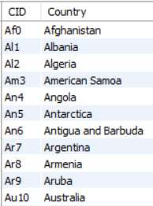
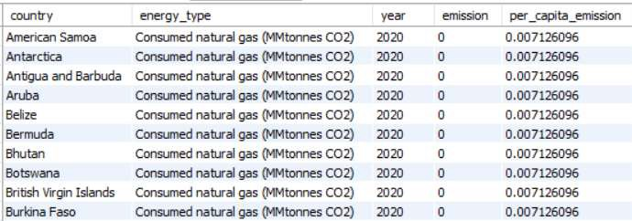
TABLES
COUNTRY
EMISSION_3

Slide 7
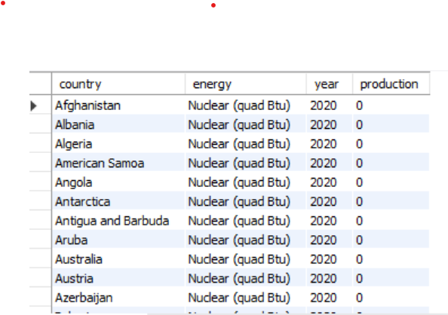
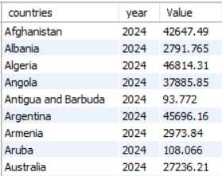
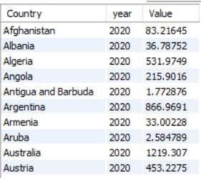
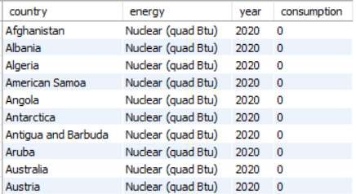
POPULATION
PRODUCTION
GDP_3
CONSUMPTION

Slide 8
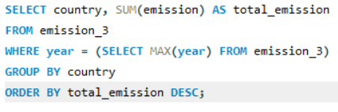
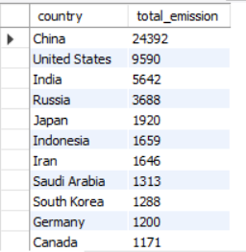
Data Analysis
General & Comparative Analysis
What is the total emission per country for the most recent year available?
OUTPUT

Slide 9
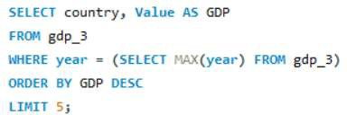
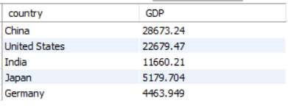
What are the top 5 countries by GDP in the most recent year?
OUTPUT

Slide 10
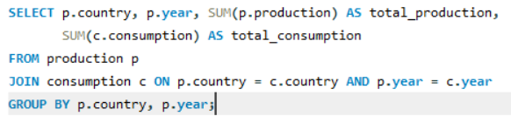
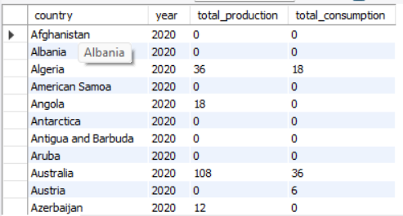
Compare energy production and consumption by country and year.
OUTPUT

Slide 11
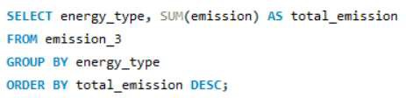
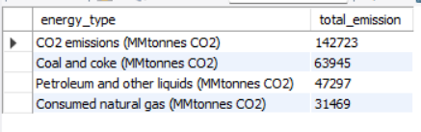
Which energy types contribute most to emissions across all countries ?
OUTPUT

Slide 12
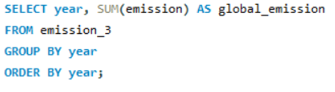
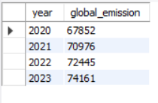
Trend Analysis Over Time
How have global emissions changed year over year?
OUTPUT

Slide 13
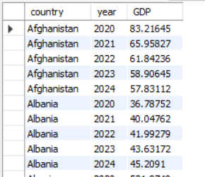

What is the trend in GDP for each country over the given years?
OUTPUT

Slide 14
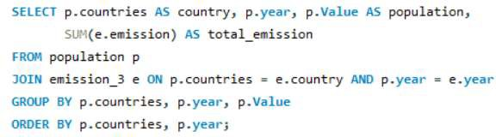
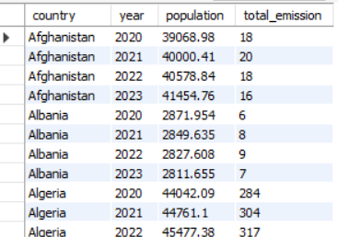
How has population growth affected total emissions in each country ?
OUTPUT

Slide 15
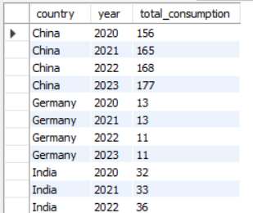
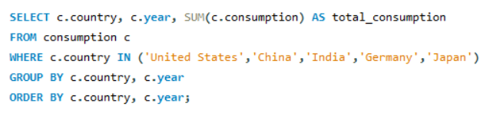
Has energy consumption increased or decreased over the years for major economies?
OUTPUT

Slide 16
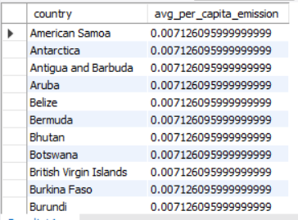
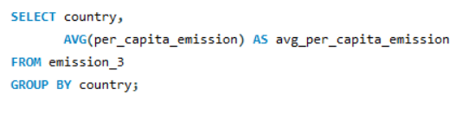
What is the average yearly change in emissions per capita for each country?
OUTPUT

Slide 17
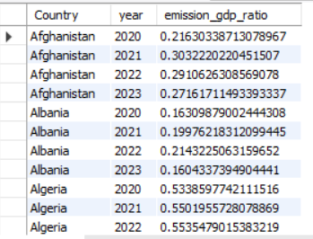
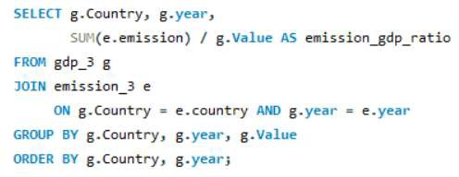
Ratio & Per Capita Analysis
What is the Emission-to-GDP ratio per country by year
OUTPUT

Slide 18
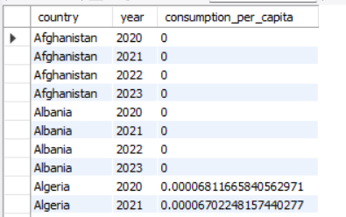
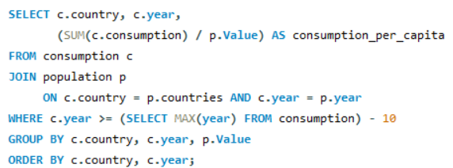
What is the energy consumption per capita for each country over the last decade?
OUTPUT

Slide 19
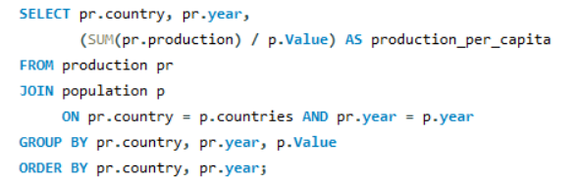
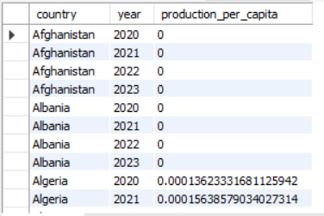
How does energy production per capita vary across countries?
OUTPUT

Slide 20
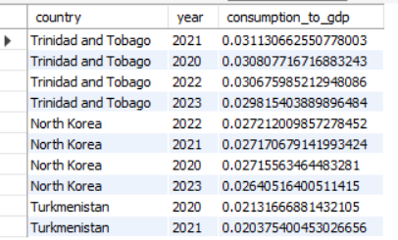
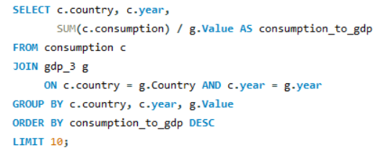
Which countries have the highest energy consumption relative to GDP?
OUTPUT

Slide 21
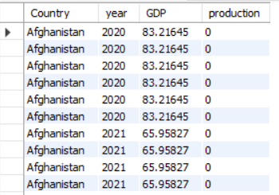
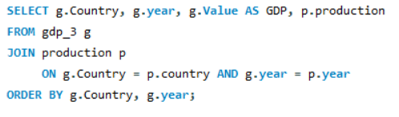
What is the correlation between GDP growth and energy production growth?
OUTPUT

Slide 22
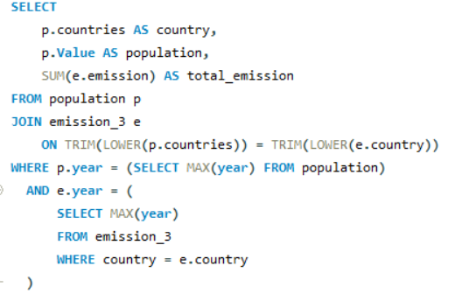
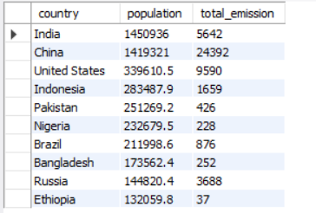

Global Comparisons
What are the top 10 countries by population and how do their emissions compare?
OUTPUT

Slide 23
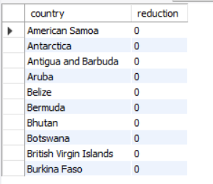
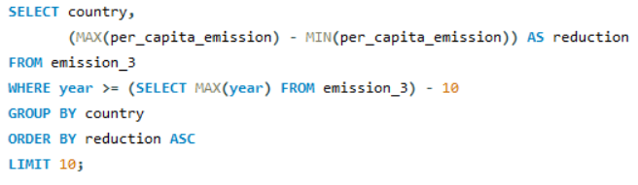
Which countries have improved (reduced) their per capita emissions the most over the last decade?
OUTPUT

Slide 24
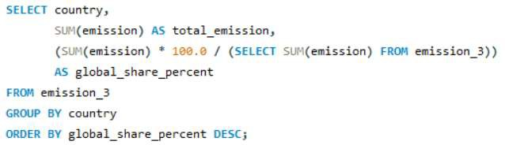
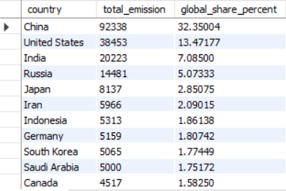
What is the global share (%) of emissions by country?
OUTPUT

Slide 25
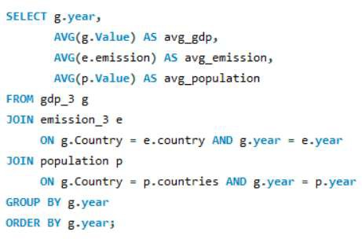
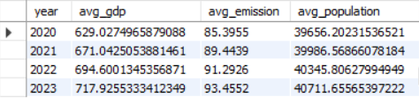
Global average GDP, emission, and population by year
OUTPUT

Slide 26
FINAL BUSINESS INSIGHTS AND RECOMMENDATIONS
Energy efficiency investment: Nations showing a high consumption-to-GDP ratio can reduce energy waste and operational costs through efficiency improvements.
Support developing economies: Providing assistance in cleaner technologies can help lower emissions without hindering economic growth.
Shift towards renewables: Countries with high emission-to-GDP ratios must accelerate clean energy adoption, as current levels are not up to the mark.

Slide 27
CONCLUSION
Energy demand is increasing with population and GDP growth.
Fossil fuels continue to dominate, keeping emissions high.
China, the USA, and India are the largest contributors to emissions.
Emissions are rising year over year.
Some countries show efficiency gains, proving that change is possible.
The future depends on clean energy adoption and sustainable policies

Slide 28

THANK YOU

